Slide 1
Using Cortana Intelligence Suite in your Hacks or Student Projects
Name
Title
Microsoft
Twitter/Email
Notes:
Introduce yourself and your role within Microsoft

Slide 2
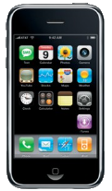
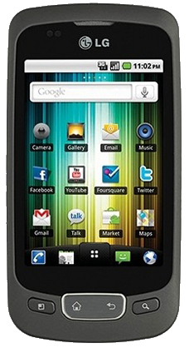
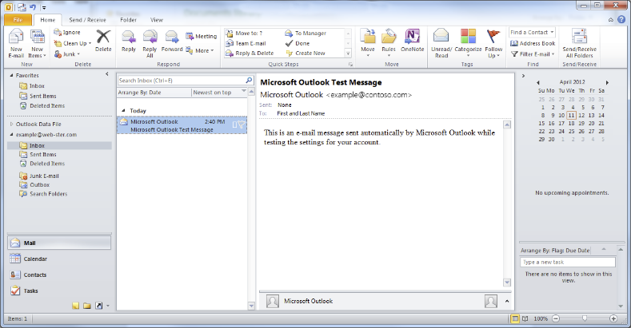
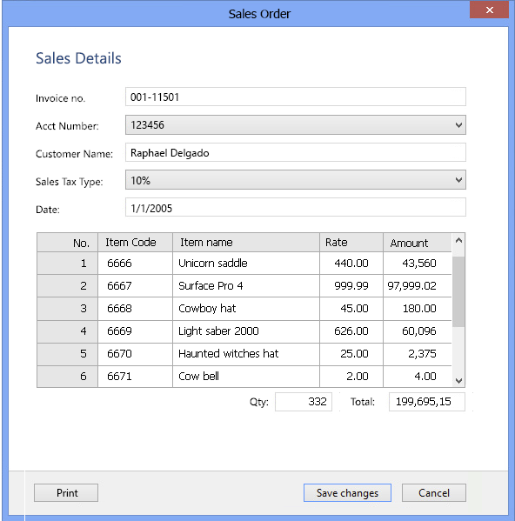
2010
Notes:
Back in 2010 we lived in a split of mobile and desktop simple application conntecting web services and databases.

Slide 3

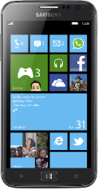

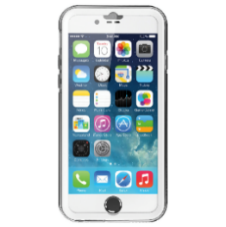
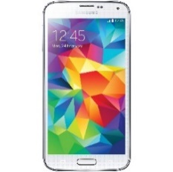
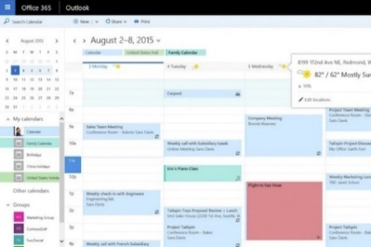

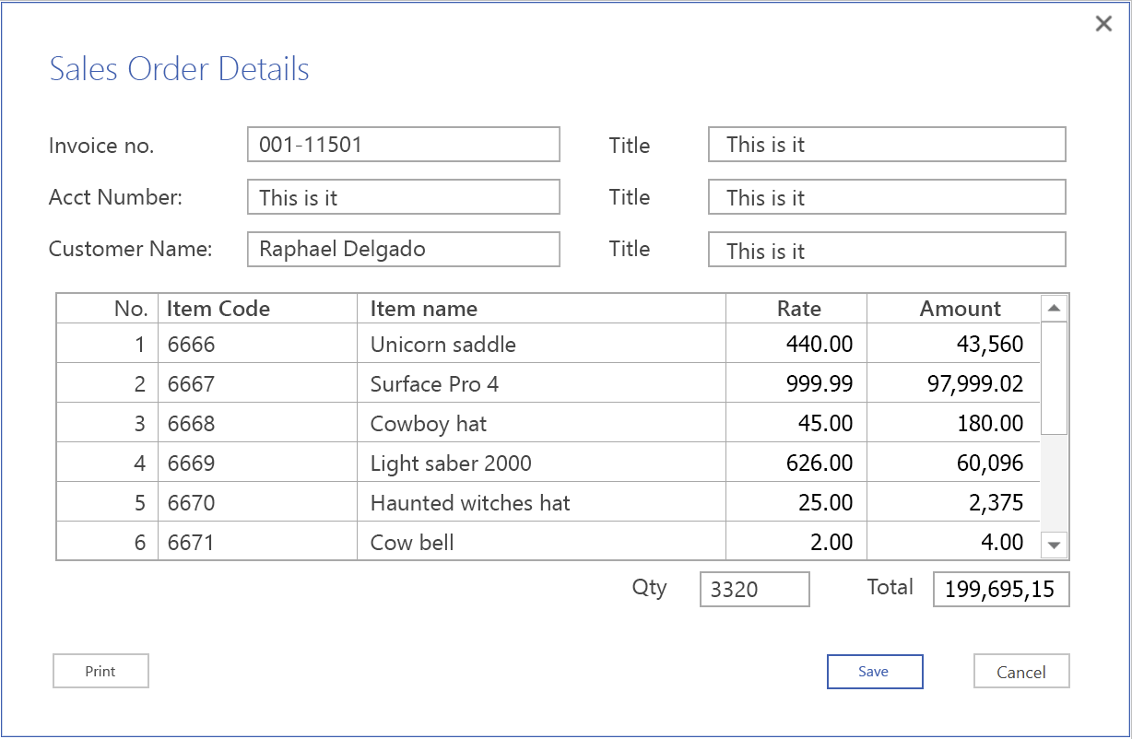
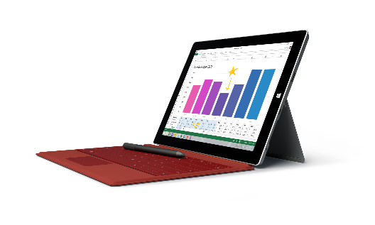
2015
Notes:
In 2015 application become much more advanced and complex with web service connecting to a variety of devices and plaforms with applications being mobile, desktop and hybrid application became powered by various services including Databases, Hadoop Big Data and Restful services. This was start of the intelligent application.

Slide 4
Characteristics of an Intelligent App
How the user sees it…
What it means for you as a Dev…
Personalized, friendly, approachable, natural
Facial recognition, emotion detection
Text and speech interactions
360 awareness of the user
Predictive, current, and familiar
Changes in real-time based on user action and new external data
Predictive models based on user context to anticipate actions
Always available, always contextual
Robust information management required
Experiences delivered across all form factors and a wide variety of interaction models (e.g. touch, speech, text)
Distributed support, massive scale, elasticity
Notes:
So what are the key characteristics of an intelligent app. Lets look at this from users and developers..

Slide 5

Cognitive Services
Vision
From faces to feelings, allow your apps to understand images and video
Microsoft Cognitive Services
Give your apps a human side
Speech
Hear and speak to your users by filtering noise, identifying speakers, and understanding intent
Language
Process text and learn how to recognize what users want
Knowledge
Tap into rich knowledge amassed from the web, academia, or your own data
Search
Access billions of web pages, images, videos, and news with the power of Bing APIs
Notes:
So welcome to Microsoft Cognitive Services - Cognitive services include, Vision, Speech, Language, Knowledge and Search and your perfect companion for any Hack or Project which your about to undertake

Slide 6

Cortana Intelligence Suite Intelligent Apps require Intelligent Solutions
Information Management
Big Data Stores
Machine Learning and Analytics
Intelligence
Data Sources
People
Data Factory
Data Lake Store Blob Store
Machine Learning
Cognitive Services
Data Catalog
SQL Data
Warehouse
Data Lake Analytics
Bot Framework
Web
Apps
HDInsight
(Hadoop and Spark)
Event Hub
Cortana
Mobile
Apps
Stream Analytics
Bots
Dashboards & Visualizations
Sensors and devices
Power BI
Automated Systems
Data
Intelligence
Action
Notes:
The Microsoft Cortana Intelligence Suite is a fully managed big data and advanced analytics suite to transform your data into intelligent action and your application simple become the end result of the action. As we stated at the beginning of this presentation 2015 was the birth of the intelligent app, todays apps have three key aspects, Data, Intelligence and Action. Cortana Intelligence Suite offer a portfolio of applications and services to support the intelligence within modern day applications.

Slide 7







Why Microsoft Cognitive Services ?
Easy
Flexible
Tested
Roll your own with REST APIs
Simple to add: just a few lines of code required
Make the same API code call on iOS, Android, and Windows
Integrate into the language and platform of your choice
Built by experts in their field from Microsoft Research, Bing, and Azure Machine Learning
Quality documentation, sample code, and community support
GET A KEY
BUILD
Notes:
Simply with Cognitive Services its Easy, Flexible and tested we have a great number of sample. Available for a variety of platforms using a large number of languages.

Slide 8

Cognitive Services
microsoft.com/cognitive
Vision
Speech
Language
Knowledge
Search
Computer Vision
Custom Recognition
Bing Spell Check
Academic Knowledge
Bing
Web Search
Emotion
Speaker Recognition
Linguistic Analysis
Entity Linking
Bing
Image Search
Face
Speech
Language Understanding
Knowledge Exploration
Bing
Video Search
Video
Translator
Text Analytics
Recommendations
Bing
News Search
WebLM
Bing
Autosuggest
Notes:
Here is a selection of the various services which are included under Microsoft Cognitive Services.

Slide 9
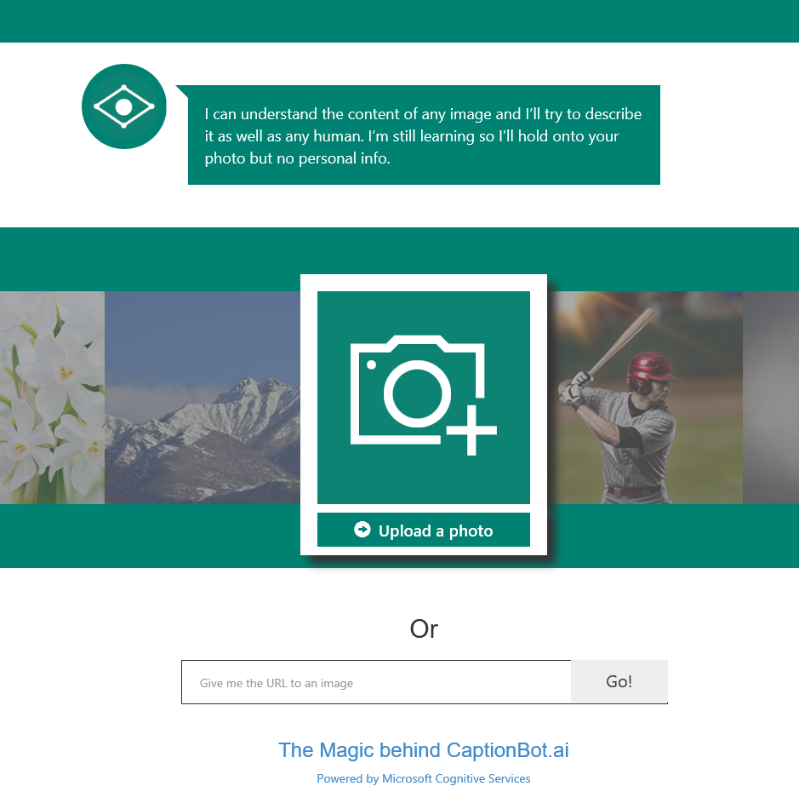
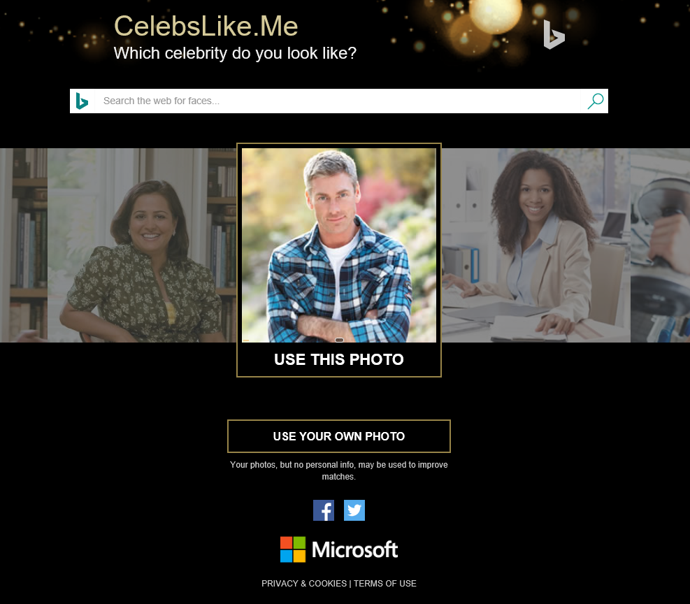
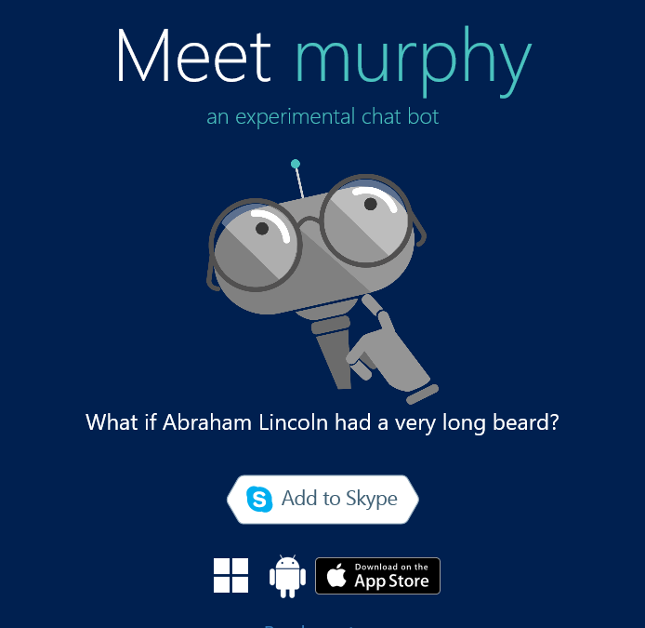
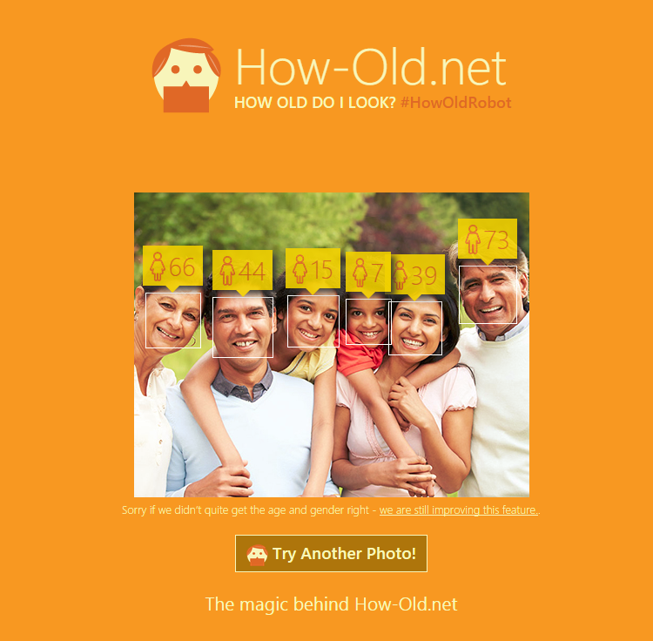
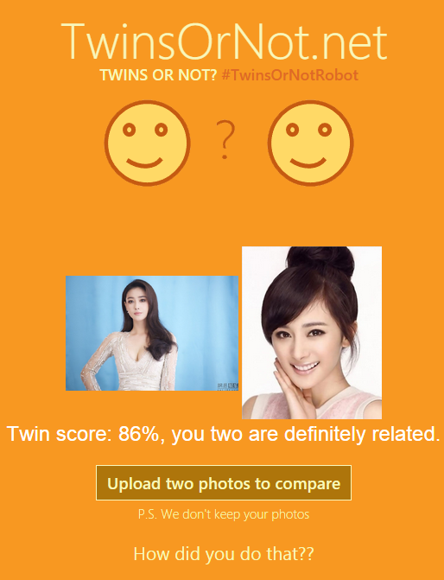
Apps Powered by MS Cognitive Services
Captionbot.ai
CelebsLike.Me
Projectmurphy.net
How-Old.net
TwinsOrNot.net
Notes:
To help you understand the opportunity of Microsoft Cognitive Services, we have developed a number of show case sites to demonstrate the power of the Vision, Speech, Language, Knowledge and Search APIs.

Slide 10
DEMO
Start coding
Caption Bot AI & Sample Apps
Notes:
Simply use the following demos
www.captionbot.ai
www.howold.net
Or one of the other demo sites

Slide 11
Accessing the APIs
Obtain API subscription key from http://www.microsoft.com/cognitive
Call REST endpoint, and pass API
Notes:
To Access Cognitive Services you simply have to follow these 2 steps.

Slide 12

Bot Framework Preview Your bots – wherever your users converse
Bot Connector Service
Connect your bot(s) seamlessly to text/sms, Office 365 mail, Skype, Slack, Twitter and more
A service to register your bot, configure channels and publish to the Bot Directory
Bot Builder SDK
Everything you need to build great dialogs within your Node.js or C# bot
An open source SDK hosted on GitHub
Bot Directory
Discover, try, and add bots to conversation experiences
A public directory of bots registered and approved with Bot Framework
www.botframework.com
Notes:
Another opportunity is the Microsoft Bot Framework, the Bot Framework allows you to Build and connect intelligent bots to interact with your users naturally wherever they are, from text/sms to Skype, Slack, Office 365 mail and other popular services

Slide 13
DEMO
Start coding
Project Murphy Skype Bot Demo
Notes:
A great demo for using a Skype Bot is Project Murphy see http://www.projectmurphy.net/
For instructions see https://blogs.msdn.microsoft.com/uk_faculty_connection/2016/06/03/project-murphy-microsoft-bot-framework-ai/

Slide 14

Vision APIs Analyze an Image
OCR
Get Thumbnail
Notes:
Now lets take a closer look at the cognitive Services APIs firstly lets look at the vision API, the Vision API allows you to analyze images, use OCR on images and create thumbnails

Slide 15
Analyze Image Service
Understand content and features within an image
Notes:
One of the main features of the Cognitive Services vision API is the ability of the API to understand content and features within a imagine, such as face, a person, the type of activity the individual is undertaking or the text within the image.

Slide 16
DEMO
Start coding
Demo of Emotion via a Win32 App
Notes:
Another great feature of the cognitive services API is the ability to evaluate the emotions of individuals in the following demo I going to live demonstrate how the cognitive services API can recognise a variety of emotions.
For the demo see the ZIP folder containing the demo apps (Please simply add your Cognitive API key to the LiveEmotion.exe.config

Slide 17
OCR Service
Detect and recognize words within a photo
Notes:
Another great API is the OCR service this simply allows you to process a image and detect any text on the image.

Slide 18

OCR – Example
TEXT:
LIFE IS LIKE
RIDING A BICYCLE
TO KEEP YOUR BALANCE
YOU MUST KEEP MOVING
JSON:
{
"language": "en",
"orientation": "Up",
"regions": [
{
"boundingBox": "41,77,918,440",
"lines": [
{
"boundingBox": "41,77,723,89",
"words": [
{
"boundingBox": "41,102,225,64",
"text": "LIFE"
},
{
"boundingBox": "356,89,94,62",
"text": "IS"
},
{
"boundingBox": "539,77,225,64",
"text": "LIKE"
}
. . .
Notes:
Here a great example of how the OCR API identifies text within a image and output the results in a simple JSON format as you can see from the JSON the Text is clearly identified within bounding boxes which provide the location of each of the elements within the image.

Slide 19
DEMO
Start coding
OCR with Python
Walkthrough https://blogs.msdn.microsoft.com/uk_faculty_connection/2016/03/30/using-python-and-project-oxford-vision-api-to-ocr-a-online-image-from-any-url/
Notes:
In the following demo I want to simply show how simple and fast is it to use the OCR API using only a few lines of Python
See https://blogs.msdn.microsoft.com/uk_faculty_connection/2016/03/30/using-python-and-project-oxford-vision-api-to-ocr-a-online-image-from-any-url for a complete code solution for using Python and the OCR API

Slide 20

Face APIs Detection
Verification
Grouping
Identification
Notes:
The next API is the Face API this allows you to undertake, face detection, verification, grouping and identification.

Slide 21

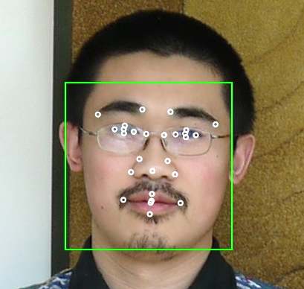
Face API – Detection
Detection Result:
JSON:
[
{
"faceRectangle": {
"width": 109,
"height": 109,
"left": 62,
"top": 62
},
"attributes": {
"age": 31,
"gender": "male",
"headPose": {
"roll": "2.9",
"yaw": "-1.3",
"pitch": "0.0"
}
"faceLandmarks": {
"pupilLeft": {
"x": "93.6",
"y": "88.2"
},
"pupilRight": {
"x": "138.4",
"y": "91.7"
},
...
DETECTION
ATTRIBUTES
INPUT IMAGE
FACIAL RECTANGLE + LANDMARKS
Notes:
Detect human faces and compare similar ones, organize people into groups according to visual similarity, and identify previously tagged people in images.

Slide 22
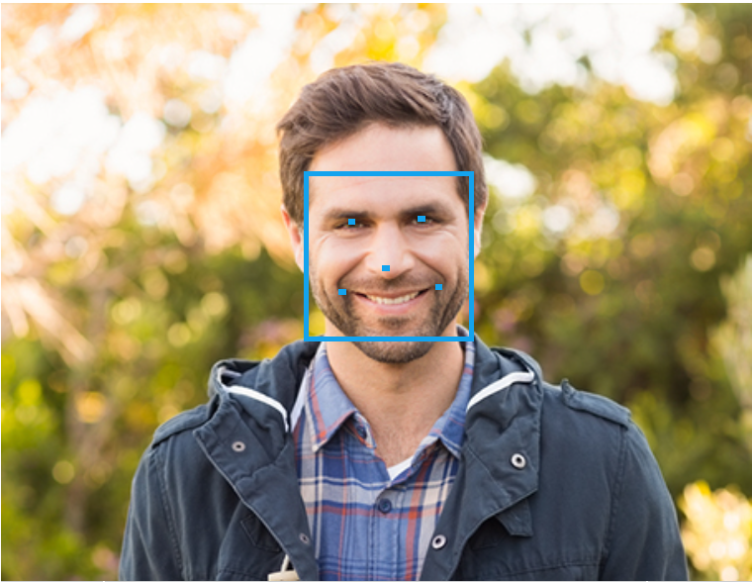
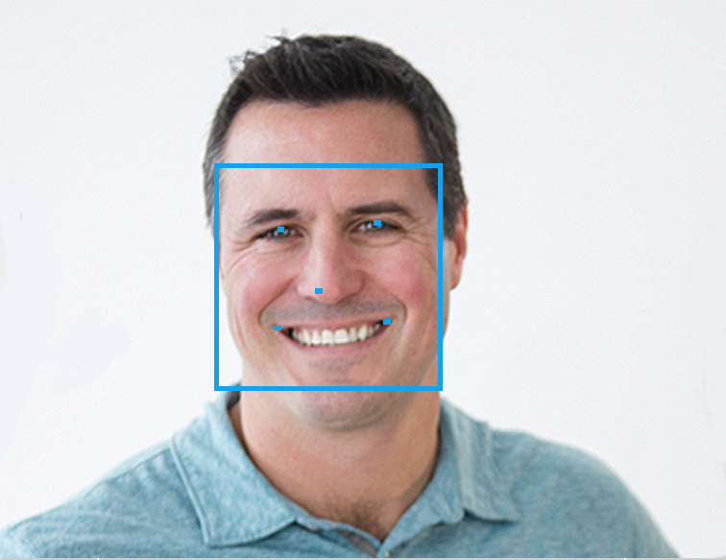
Face API – Verification
Given two faces, determine whether they are the same person
Verification Result:
JSON:
[
{
"isIdentical":false,
"confidence":0.01
}
]
Notes:
Easily find similar-looking faces. Given a collection of faces and a new face as a query, this API will return a collection of similar faces. The API can check the likelihood that two faces belong to the same person. The API will return a confidence score about how likely it is that the two faces belong to one person.

Slide 23


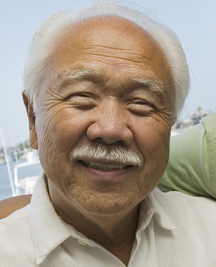









Face API – Grouping
CLUSTERED BY
DETECTED PEOPLE
Notes:
Organize many unidentified faces together into groups, based on their visual similarity.

Slide 24
DEMO
Start coding
Face Detection – MVC Web Application
Walkthrough https://blogs.msdn.microsoft.com/martinkearn/2016/03/22/introducing-howhappy-co-uk/
Notes:
In this demo we going to be using a RESTful API to Microsoft Cognitive Servcies.
Tips. take a picture of the audience or have a picture which you can upload to the web service you can visit http://howhappy.azurewebsites.net/ or download the solution https://blogs.msdn.microsoft.com/martinkearn/2016/03/22/introducing-howhappy-co-uk and publish this your own Azure Web Site.

Slide 25

Speech APIs powered by Bing
Voice Recognition (Speech to Text)
Voice Output (Text to Speech)
Notes:
Convert audio to text, understand intent, and convert text back to speech for natural responsiveness.

Slide 26

Voice Recognition
es-ES
de-DE
fr-FR
en-GB
it-IT
en-US
zh-CN
Converts spoken audio to text
Same backend which powers Cortana
Support for 7 languages at launch
Notes:
The API can be directed to turn on and recognize audio coming from the microphone in real-time, recognize audio coming from a different real-time audio source, or to recognize audio from within a file. In all cases, real-time streaming is available, so as the audio is being sent to the server, partial recognition results are also being returned. The Speech to Text API enables you to build smart apps that are voice triggered. To see how it works select your target language then click on the microphone and start speaking. Or simply click on one of the sample speech phrases to see how speech recognition works. When you use this demo you consent to providing your voice input data to Microsoft for service improvement purposes.

Slide 27
Voice Recognition
REST API
Client Library
SUPPORTED PLATFORMS
Any
Windows, Android, iOS
DATA SUPPORT
Yes
Yes
MIC SUPPORT
No
Yes
SILENCE DETECTION ON MIC
No
Yes
LENGTH OF UTTERANCE
Short
Short and long
NUMBER OF RESPONSES
n-best response back
multiple partial results, n-best (short) and multiple phrases (long)
Windows 10 has Speech APIs built in
Notes:
Here the support offered my Microsoft Cognitive Voice APIs

Slide 28

Language Understanding Intelligent Service Determine Intent
Detect Entities
Improve Models
Notes:
Microsoft Language Understanding Intelligent Service (LUIS) service are used to generate the intent.

Slide 29
Language Understanding Intelligent Service
Lets you understand what your users are saying
Seamless integration with Speech Recognition
A few examples are enough to deploy an application
LUIS learns over time
Define
Concepts
Provide
Examples
Deploy
Active Learning
Notes:
Language Understanding Intelligent Service (LUIS)
Understand language contextually, so your app communicates with people in the way they speak.

Slide 30
DEMO
Start coding
LUIS with Python
Walkthrough https://blogs.msdn.microsoft.com/uk_faculty_connection/2016/03/29/getting-started-using-microsoft-project-oxford-language-understanding-intelligent-service-luis-3-2/
Notes:
In this demo we will build a simple app which will use LUIS
The app is a Pizza Ordering Sytem where a user can order a pizza and toppings
See https://blogs.msdn.microsoft.com/uk_faculty_connection/2016/03/29/getting-started-using-microsoft-project-oxford-language-understanding-intelligent-service-luis-3-2
You need to Build and Train your LUIS engine

Slide 31
Resources
http://cortanaintelligence.com
http://gallery.cortanaintelligence.com
http://www.microsoft.com/cognitive
Azure Grants for Education
http://aka.ms/azureforeducation
Notes:
Here a set of all the resources you need to get started building amazing projects and hacks using the Microsoft Cognitive services and Cortana Intelligence Suite.

Slide 32
Notes:
Questions

